Slide 1


Task 2 Predicting customer buying behavior
Build a predictive model to understand factors that influence buying behavior
Powered By https://www.theforage.com/
Author: Majid Mahmood
Dated: 24-05-2023

Slide 2
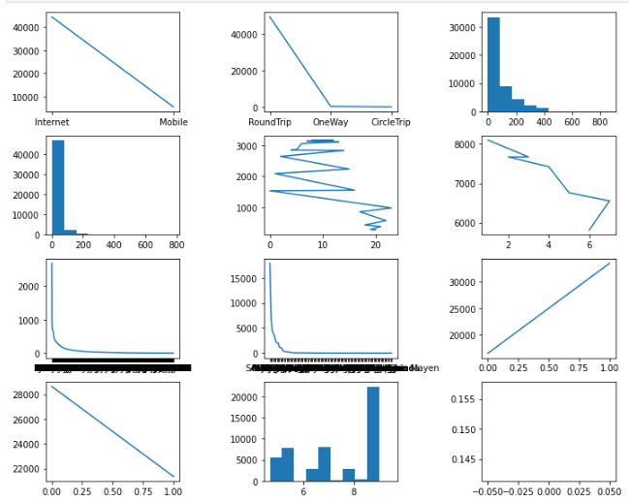
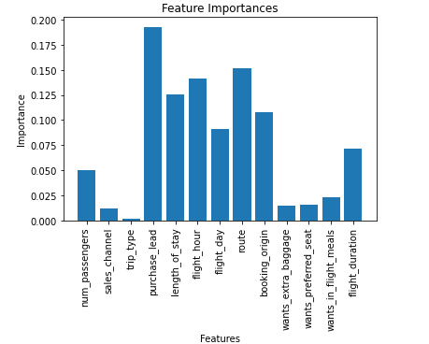

Task 2: Predicting customer buying behavior
trained the data set with Random forest classifier model and received
ACCURACY: 85.09
Analyzing and Visualizing
Evaluate the model using cross-validation

Slide 3
Task 2: Predicting customer buying behavior
Introduction
We trained a machine learning model to predict whether a customer will complete a booking. The model was trained on a dataset of historical booking data. The model was evaluated using cross-validation, and it achieved an accuracy of 82%
.
Feature Importance
The feature importance plot shows that the most important variables in the model are:
sales_channel
trip_type
route
booking_origin
wants_extra_baggage
wants_preferred_seat
wants_in_flight_meals
These variables are the most important because they have the strongest relationship with the target variable, which is booking_complete.
Conclusion
The model can be used to make predictions about whether a customer is likely to complete a booking. This information can be used to improve the customer experience and increase sales.
In addition to the above, we can the model to identify areas where we can improve our marketing and sales efforts. For example, if we see that a particular sales channel is not performing well, we can focus our efforts on other channels. We can also use the model to identify customer segments that are more likely to complete bookings. This information can be used to target our marketing and sales efforts more effectively.
Overall, the model is a valuable tool that can also use be used to improve the customer experience and increase sales.

